Slide 1

Power-Efficient FinFET-Based Sense Amplifier
2310040095 : Sayooj
2310040076 : Venkat prasad
2310040004 : Sameer

Slide 2
Introduction to Sense Amplifiers
Sense amplifiers detect and amplify small voltage differences between bitlines in memory circuits.
They improve read speed and reliability in SRAM, DRAM, and other sensing applications.
Key design factors include speed, power efficiency, and noise tolerance.
FinFET-based sense amplifiers offer lower power consumption and better performance than traditional CMOS designs.

Slide 3
What is FinFet
FinFET (Fin Field-Effect Transistor) is an advanced transistor architecture used in modern semiconductor technology.
It features a 3D fin-like structure that improves control over the channel, reducing leakage and power consumption.
Compared to traditional planar MOSFETs, FinFETs offer higher speed, better energy efficiency, and reduced short-channel effects.
Widely used in low-power, high-performance applications like processors and memory circuits.

Slide 4

Key Advantages of FinFet Biased Sense Amplifiers
Low Power Consumption
Optimized for energy-efficient operations.
High Speed
Fast sensing and data retrieval.
Improved Stability
Enhanced noise margin and better performance.
Scalability
Suitable for modern semiconductor process nodes.

Slide 5
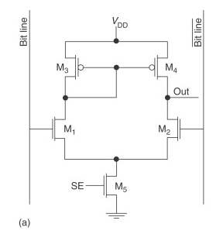
DIFFERENTIAL SENSE AMPLIFIER

Slide 6
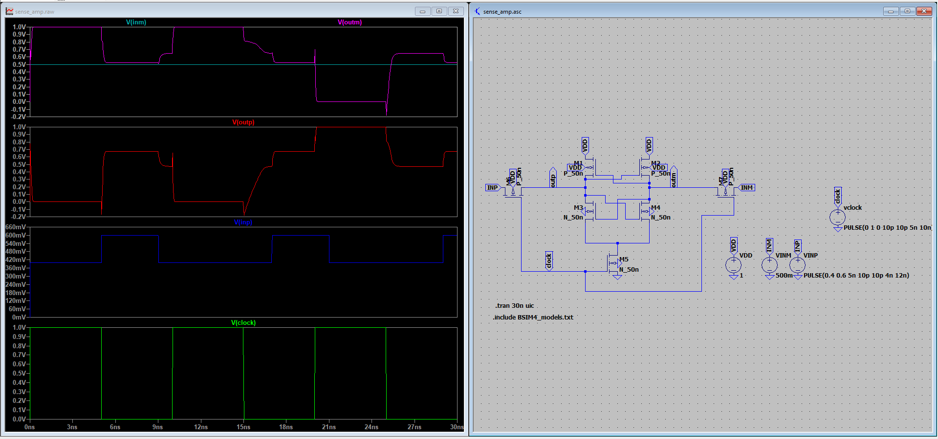

Slide 7
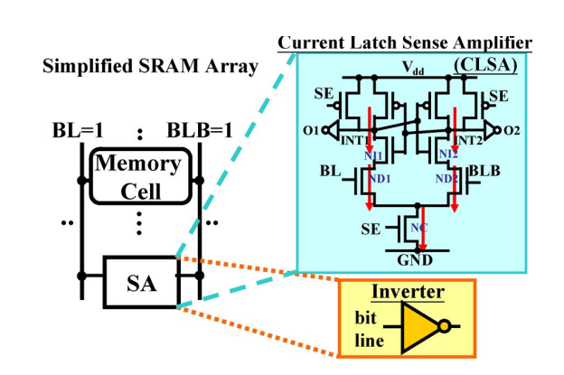
CURRENT LATCH SENSE AMPLIFIER BASED ON FINFET

Slide 8
